Slide 1
Thesis goal and current standing

Slide 2
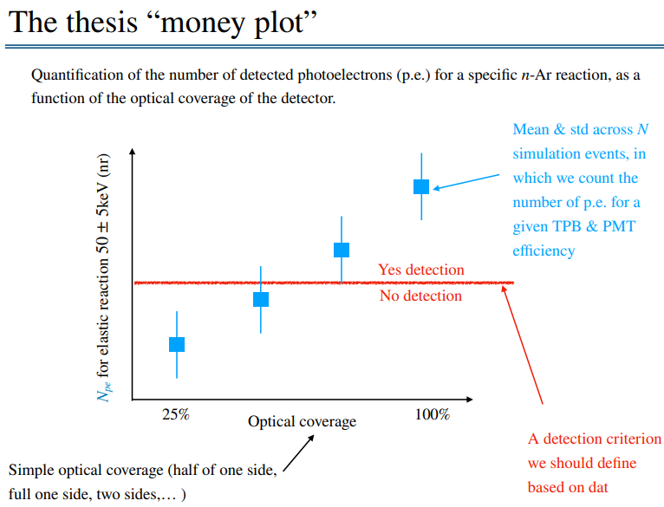
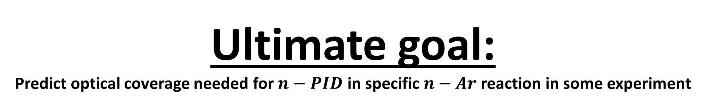
Ultimate goal:
Predict optical coverage needed for $n−PID$ in specific $n−Ar$ reaction in some experiment

Slide 3
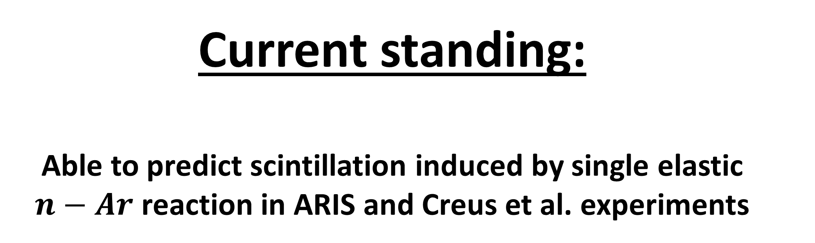
Current standing:
Able to predict scintillation induced by single elastic $n−Ar$ reaction in ARIS and Creus et al. experiments

Slide 4
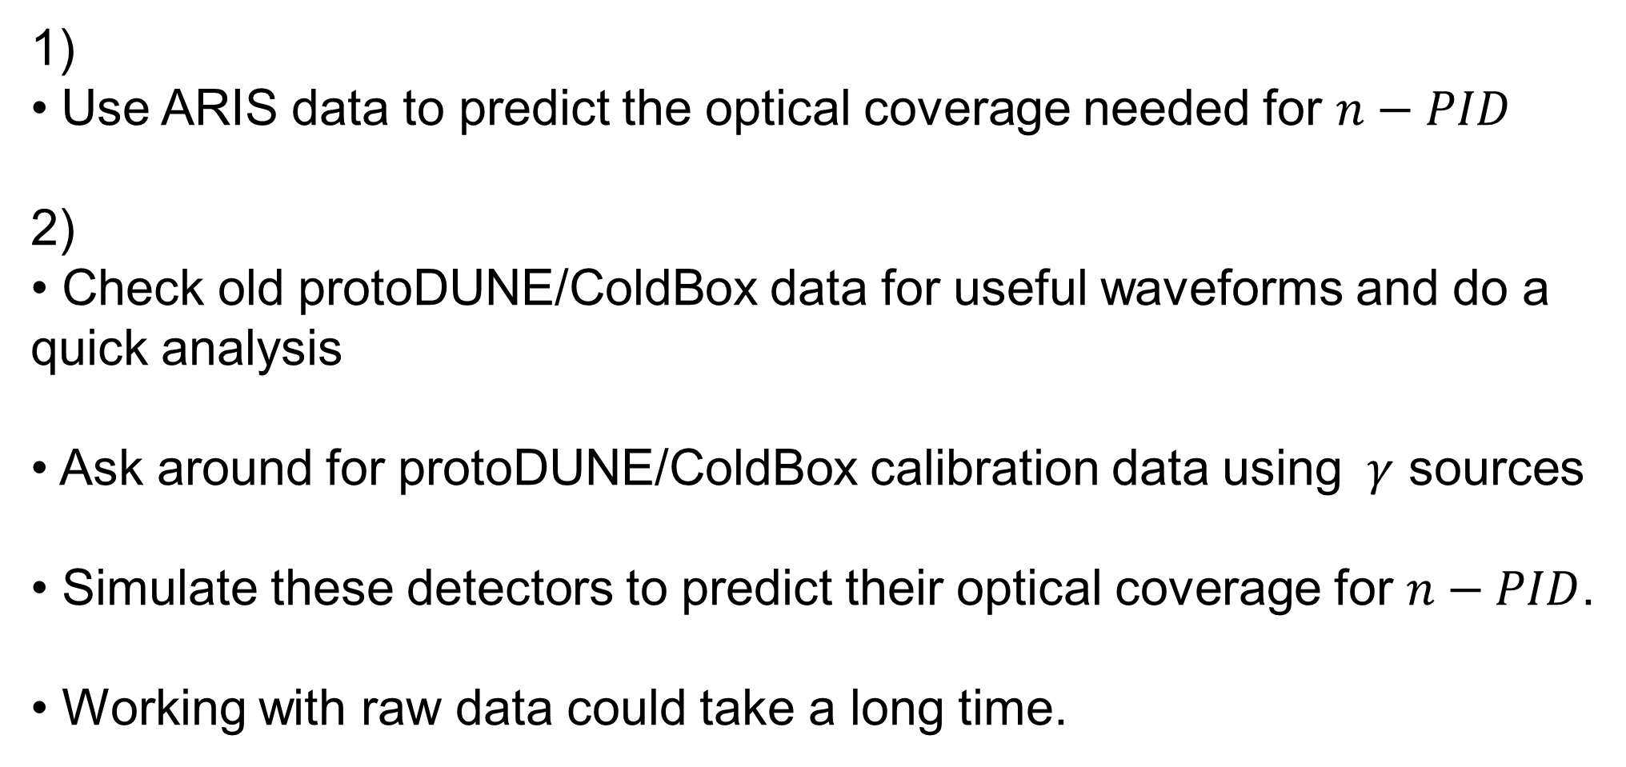
Bridging the gap - possibilities
1)
Use ARIS data to predict the optical coverage needed for $n−PID$
2)
Check old protoDUNE/ColdBox data for useful waveforms and do a quick analysis
Ask around for protoDUNE/ColdBox calibration data using $γ$ sources
Simulate these detectors to predict their optical coverage for $n−PID$.
Working with raw data could take a long time.

